Slide 1
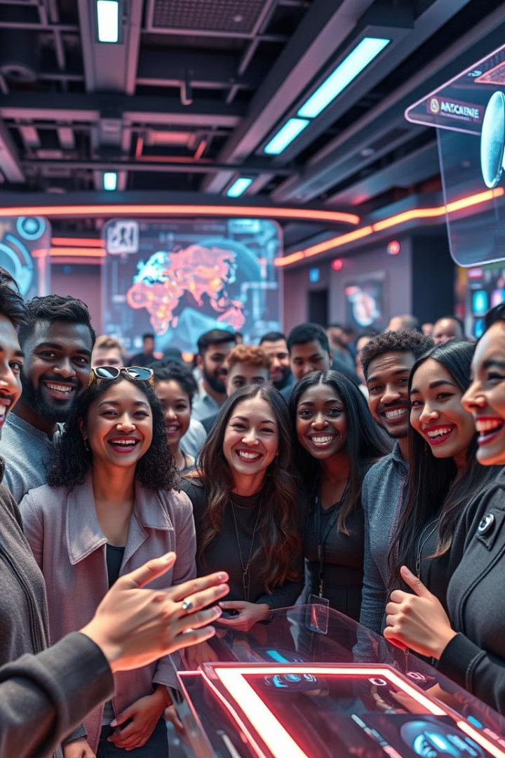
The Metaverse: Revolutionizing Virtual Communication
Presented By
1 . NISHANTHINI K
2 . SAVEETHA A
3 . WASIM ABDUL KADHAR S
4 . SASI ANANTH K

Slide 2
Introduction
The Metaverse: Revolutionizing Virtual Communication
The metaverse, a rapidly evolving virtual world, is transforming how we communicate and interact. It's a new era of digital communication, where virtual and real worlds seamlessly converge.

Slide 3
Understanding the Metaverse: What, Why, and How
What
Why
How
The metaverse is a collective virtual shared space where people can interact with each other, create, and participate in experiences using avatars. This virtual world uses augmented reality (AR) and virtual reality (VR) technologies to create immersive experiences.
The metaverse offers a platform for virtual collaboration, communication, and social interactions, transcending geographical limitations and fostering a sense of presence and community.
The metaverse is built on blockchain technology, which enables the creation of decentralized virtual economies and fosters trust and transparency.

Slide 4



Immersive Experiences: Blending the Physical and Digital
Virtual Reality
1
Users wear VR headsets for an immersive 3D experience, transporting them to virtual environments.
Augmented Reality
2
AR overlays digital information onto the real world through devices like smartphones and smart glasses.
Mixed Reality
3
MR combines elements of both AR and VR, creating a hybrid world where virtual objects interact with real-world environments.

Slide 5




Virtual Collaboration: Redefining Teamwork and Productivity
Remote Collaboration
Virtual Training and Education
Virtual Events and Conferences
The metaverse enables seamless communication and collaboration between geographically dispersed teams, facilitating virtual meetings, brainstorming sessions, and project management.
The metaverse provides immersive learning environments for training, simulations, and educational programs, enhancing engagement and knowledge retention.
The metaverse offers a platform for hosting virtual events, conferences, and exhibitions, allowing for global participation and interactive experiences.

Slide 6
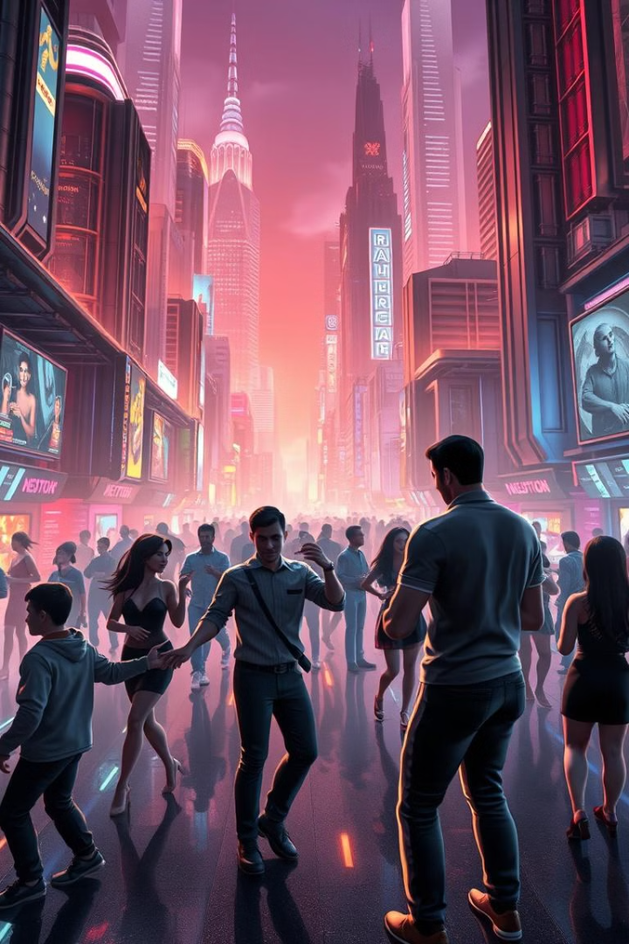



Social Interactions: Building Meaningful Connections
Virtual Games
Virtual Concerts and Events
The metaverse provides opportunities for social gaming, fostering virtual friendships and communities.
Users can attend virtual concerts, festivals, and social gatherings, experiencing live events in immersive environments.
Virtual Communities
The metaverse fosters online communities, encouraging social interactions, shared interests, and virtual friendships.

Slide 7
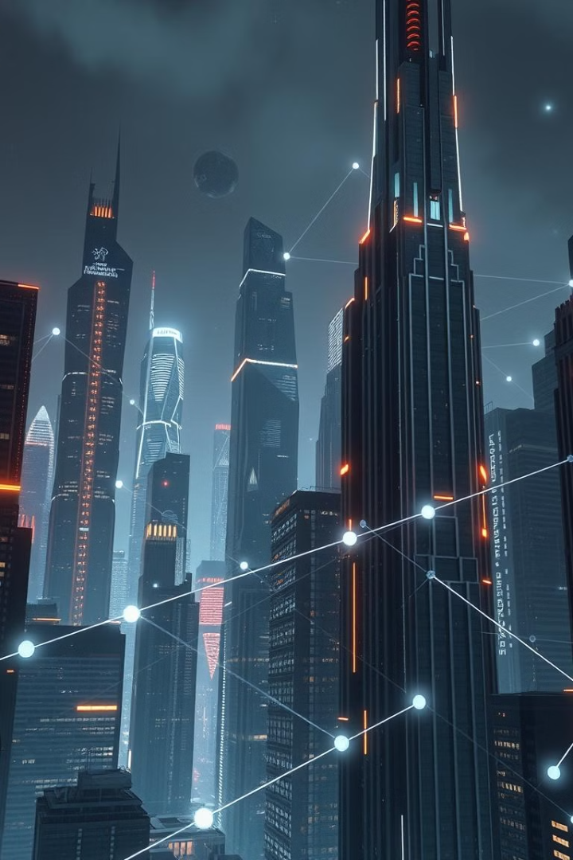
The Future of Communication: Opportunities and Challenges
1
2
New Frontiers
Ethical Considerations
The metaverse holds immense potential for innovation in communication, entertainment, education, and business, shaping the future of how we interact.
As the metaverse evolves, it's crucial to address ethical considerations related to privacy, safety, and accessibility.
3
Technological Advancements
Further development of technologies such as AR, VR, and blockchain will continue to shape the metaverse and its applications.

Slide 8
THANK YOU!

